Slide 1
1. Review 2. Scheduling Res & Costs, Ch. 8, T1
M K Hamirwasia
WILPD

Slide 2
AE ZG523/DE ZG523/ES ZG523/MM ZG523/POM ZG523-Merged
Project Management
Lecture No. 10

Slide 3
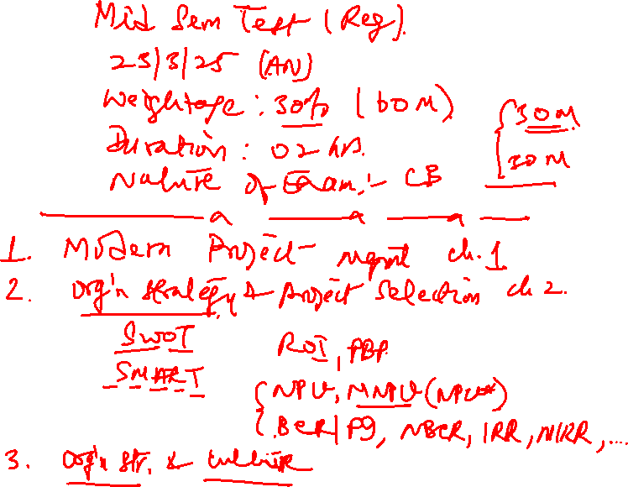

Slide 4
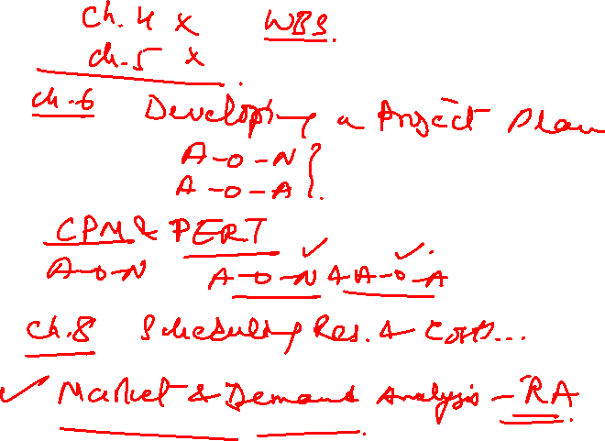

Slide 5
SCHEDULING RESOURCES and COSTS, Ch. 8, T1
M K Hamirwasia
WILPD

Slide 6

Scheduling Resources and Costs
Project networks are based on two premises:
The time estimates are based on the assumption that resources will be available as required.
The sequence of activities is based on technical / logical considerations.

Slide 7
The Resource Problem
Resources and Priorities
Project network times are not a schedule until resources have been assigned.
Cost estimates are not a budget until they have been time-phased.

Slide 8
Scheduling Resources and Costs
First prepare the resource schedule (Direct costs of people, material and equipment).
Assign time-phased costs that provide the project budget baseline – PV.
Monitor progress by checking the schedule and cost variances – actual versus planned.

Slide 9
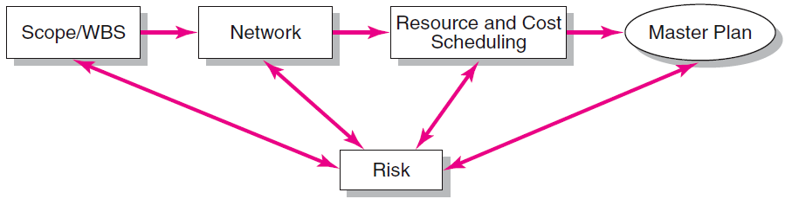
Project Planning Process

Slide 10

The Resource Problem (cont’d)
Resource Smoothing (or Leveling)
Involves attempting to even out varying demands on resources by using slack (delaying noncritical activities) to manage resource utilization when resources are adequate over the life of the project.
Resource-Constrained Scheduling
The duration of a project may be increased by delaying the late start of some of its activities if resources are not adequate to meet peak demands.

Slide 11

Types of Project Constraints
Technical or Logic Constraints
Constraints related to the networked sequence in which project activities must occur.
Physical Constraints
Activities that cannot occur in parallel or are affected by contractual or environmental conditions.
Resource Constraints
The absence, shortage, or unique interrelationship and interaction characteristics of resources that require a particular sequencing of project activities
Kinds of Resource Constraints
People, material, equipment

Slide 12
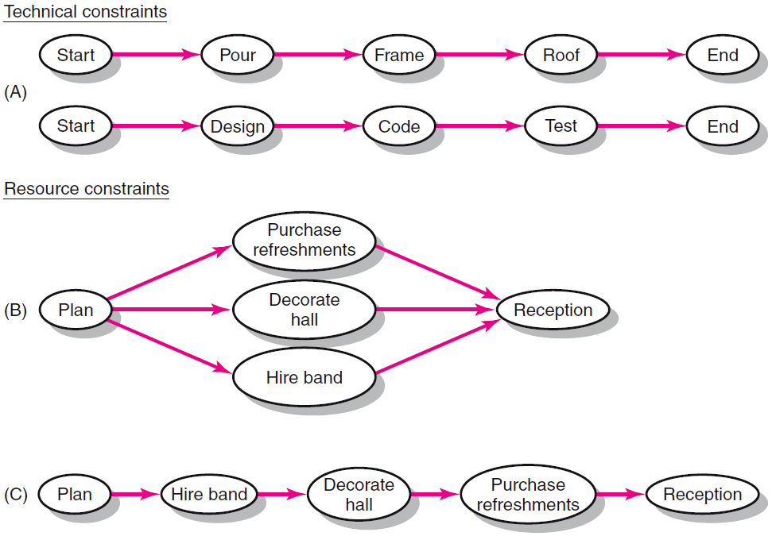
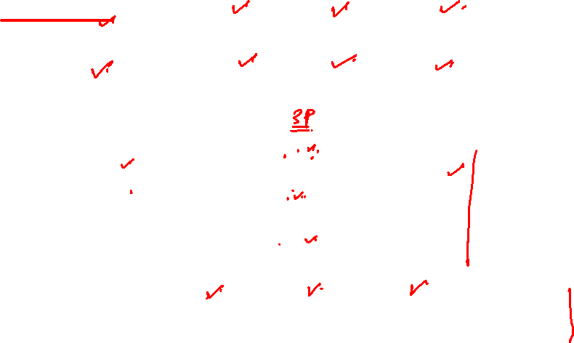
Constraint Examples

Slide 13

Classification of a Scheduling Problem
Classification of Problem
Using a priority matrix will help determine if the project is time or resource constrained.
Time-Constrained Project
Must be completed by an imposed date.
Time is fixed, resources are flexible: additional resources are required to ensure the project meets the schedule.

Slide 14
Classification of a Scheduling Problem
Resource-Constrained Project
Is one in which the level of resources available cannot be exceeded.
Resources are fixed, time is flexible: inadequate resources will delay the project.

Slide 15
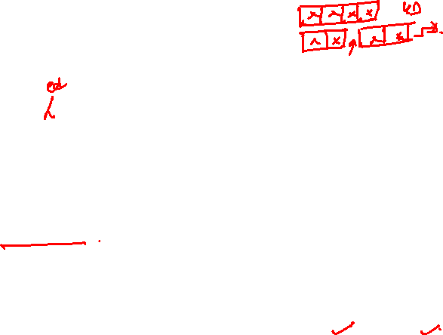
Resource Allocation Methods
Limiting Assumptions
Splitting activities is not allowed—once an activity is start, it is carried to completion.
Level of resources used for an activity cannot be changed.
Risk Assumptions
Activities with the most slack pose the least risk.
Reduction of flexibility does not increase risk.
The nature of an activity (easy, complex) doesn’t increase risk.

Slide 16
Resource Allocation Methods (cont’d)
Time-Constrained Projects
Must be completed by an imposed date.
Require use of leveling techniques that focus on balancing or smoothing resource demands.
Use positive slack (delaying noncritical activities) to manage resource utilization over the duration of the project.
Peak resource demands are reduced.
Resources over the life of the project are reduced.
Fluctuation in resource demand is minimized.

Slide 17
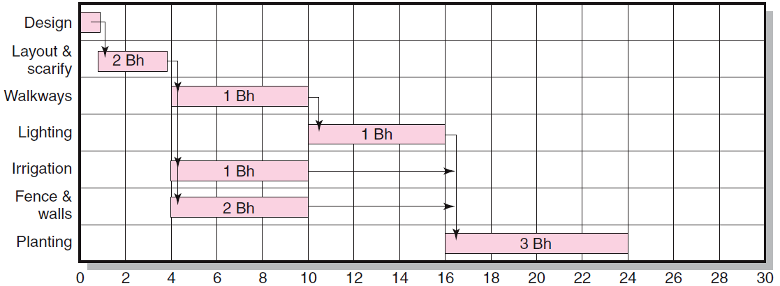
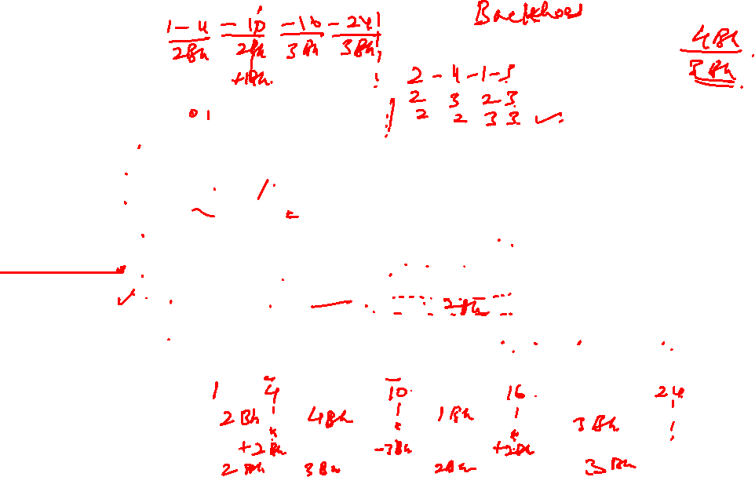
Botanical Garden

Slide 18
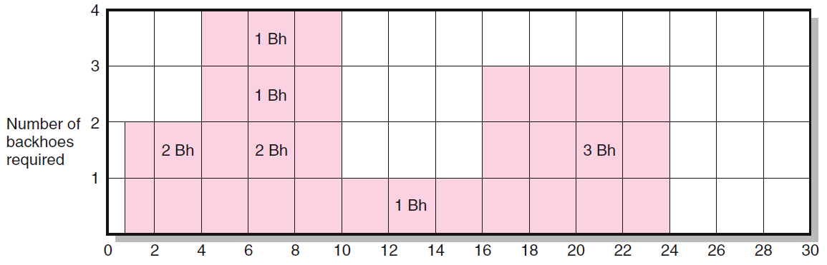
Botanical Garden

Slide 19
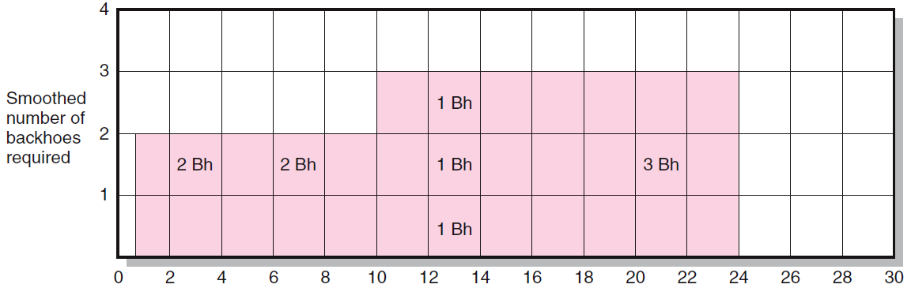
Botanical Garden

Slide 20
Resource Allocation Methods (cont’d)
Resource Demand Leveling Techniques for Time-Constrained Projects
Advantages
Peak resource demands are reduced.
Resources over the life of the project are reduced.
Fluctuation in resource demand is minimized.
Disadvantages
Loss of flexibility that occurs from reducing slack.
Increases in the criticality of all activities.

Slide 21

Resource Allocation Methods (cont’d)
Resource-Constrained Projects
Resources are limited in quantity or availability.
Activities are scheduled using heuristics (rules-of-thumb) that focus on:
Minimum slack
Smallest (least) duration
Lowest activity identification number
The parallel method is used to apply heuristics
An iterative process starting at the first time period of the project and scheduling period-by-period the start of any activities using the three priority rules.

Slide 22
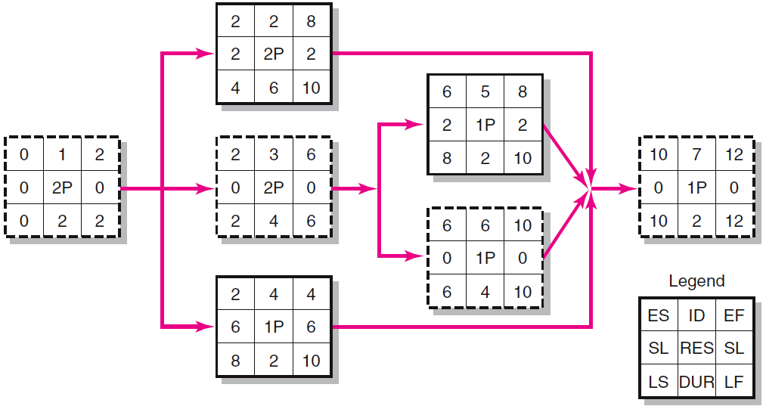
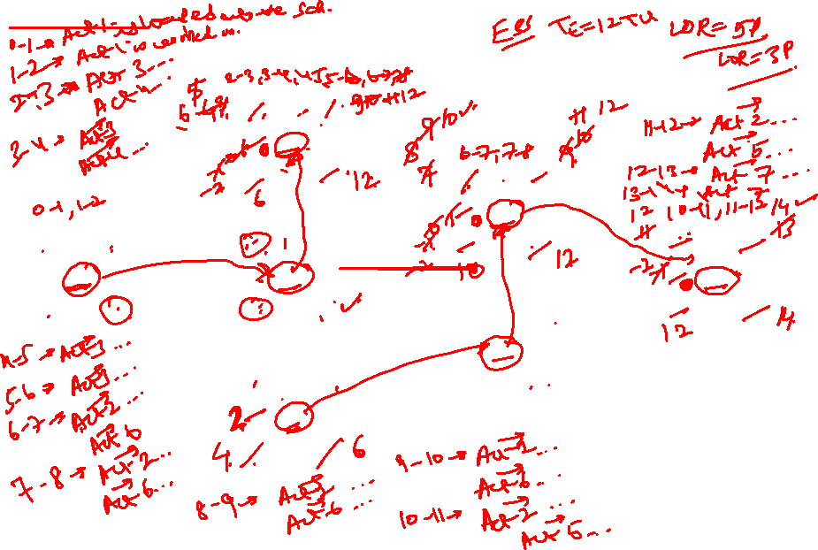
Project Network

Slide 23
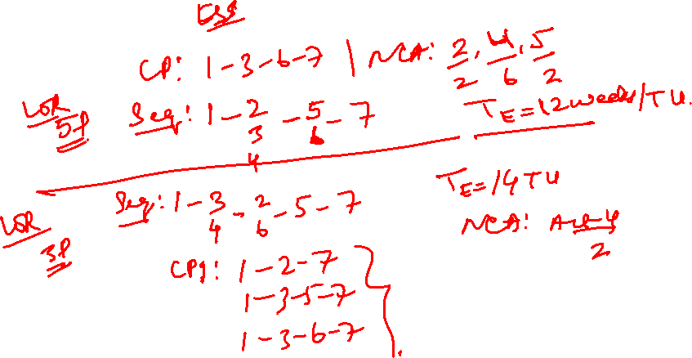

Slide 24
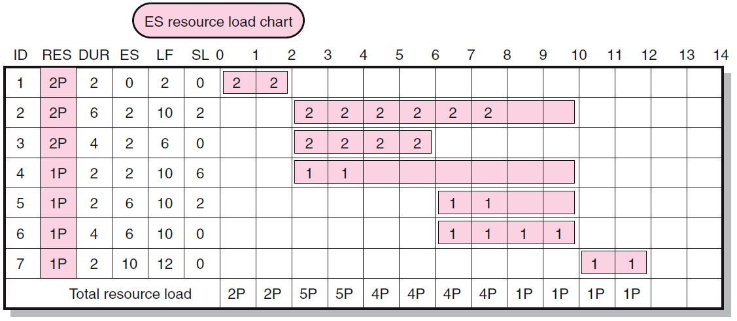
Early Start Resource Load Chart

Slide 25
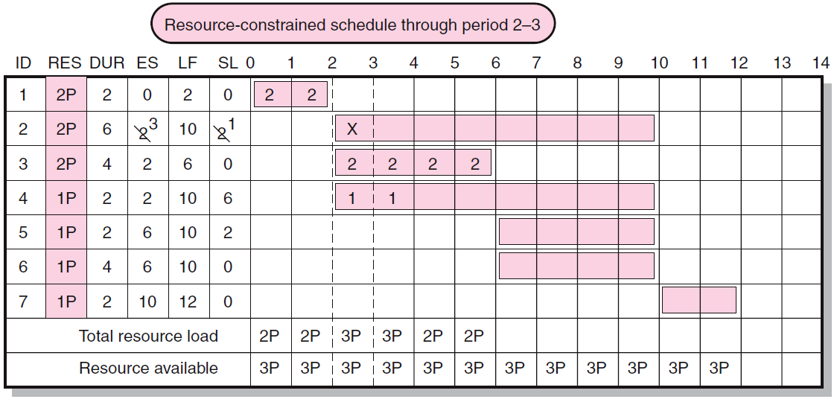
Resource-Constrained Schedule through Period 2–3

Slide 26
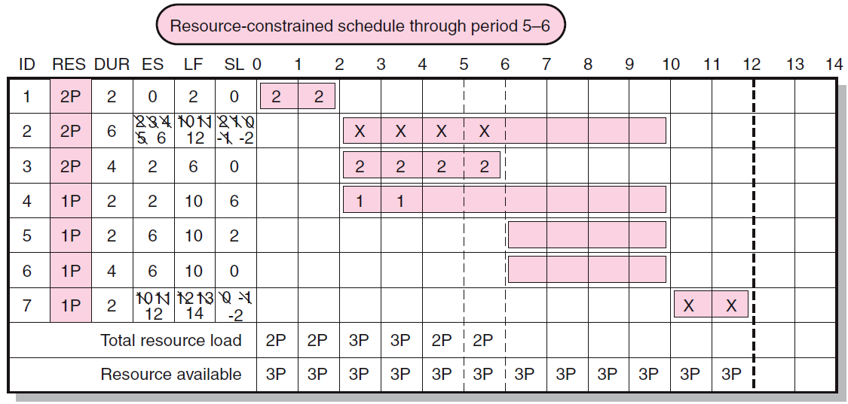
Resource-Constrained Schedule through Period 5–6

Slide 27
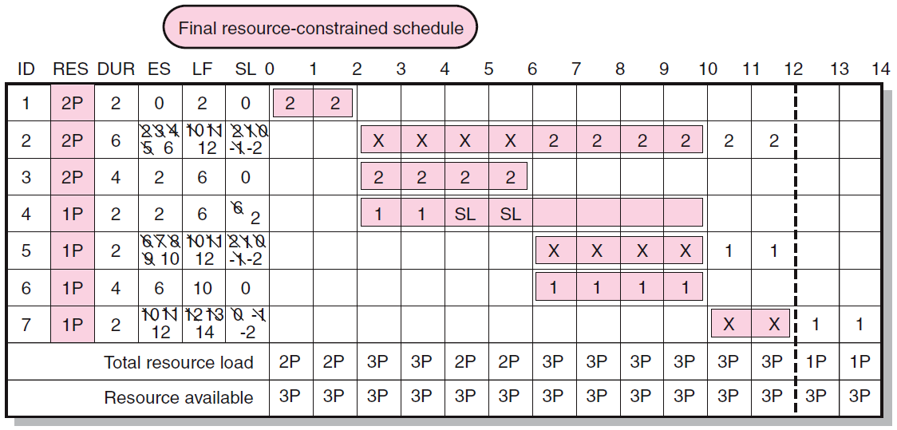
Final Resource-Constrained Schedule

Slide 28
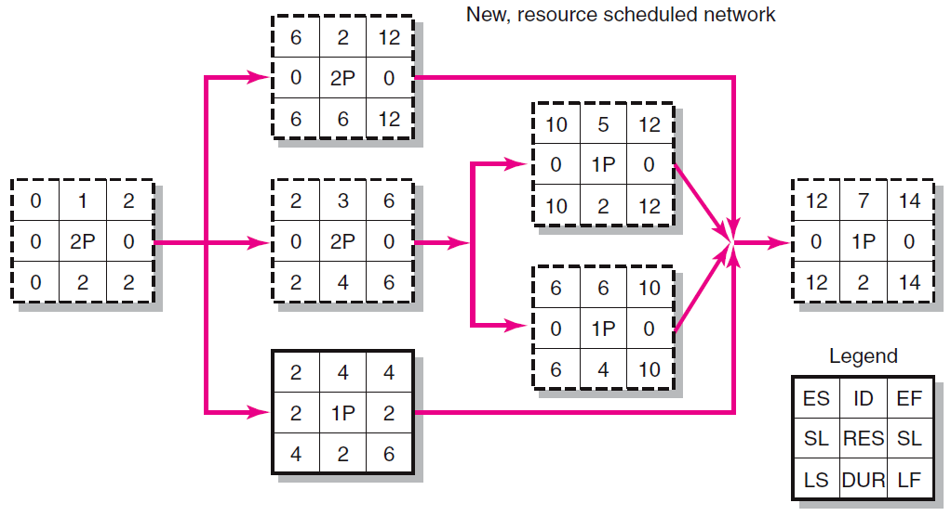

Resource Scheduled Network

Slide 29
The Impacts of Resource-Constrained Scheduling
Reduces delay but reduces flexibility.
Increases criticality of events.
Increases scheduling complexity.
May make the traditional critical path no longer meaningful.
Can break sequence of events.
May cause parallel activities to become sequential and critical activities with slack to become noncritical.

Slide 30
Splitting
Splitting
A scheduling technique used to get a better project schedule and/or increase resource utilization.
Involves interrupting work on an activity to employ the resource on another activity, then returning the resource to finish the interrupted work.
Is feasible when startup and shutdown costs are low.
Is considered the major reason why projects fail to meet schedule.

Slide 31
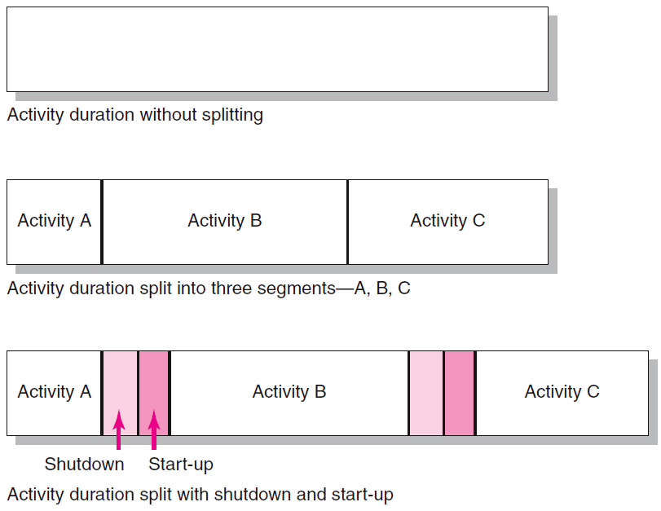
Splitting Activities

Slide 32
Benefits of Scheduling Resources
Leaves time for consideration of reasonable alternatives:
Cost-time tradeoffs
Changes in priorities
Provides information for time-phased work package budgets to assess:
Impact of unforeseen events
Amount of flexibility in available resources

Slide 33
Multi-project Resource Schedules
Multi-project Scheduling Problems
Overall project slippage
Delay on one project create delays for other projects
Inefficient resource application
The peaks and valleys of resource demands create scheduling problems and delays for projects.
Resource bottlenecks
Shortages of critical resources required for multiple projects cause delays and schedule extensions.

Slide 34
Multi-project Resource Schedules (cont’d)
Managing Multiproject Scheduling:
Create project offices or departments to oversee the scheduling of resources across projects.
Use a project priority queuing system: first come, first served for resources.
Centralize project management: treat all projects as a part of a “megaproject.”
Outsource projects to reduce the number of projects handled internally.

Slide 35
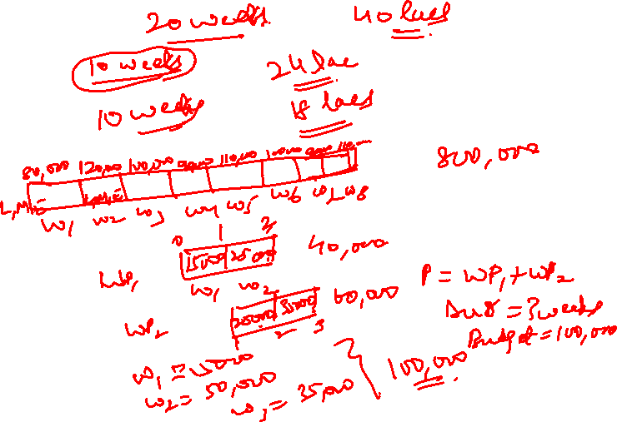

Slide 36
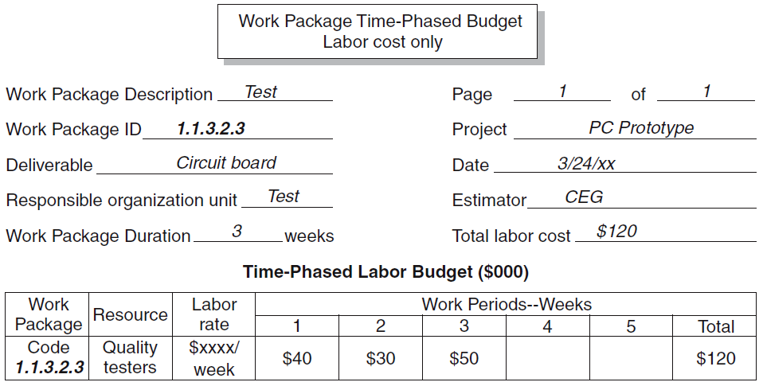
Time-Phased Work Package Budget (Labor Cost Only)

Slide 37
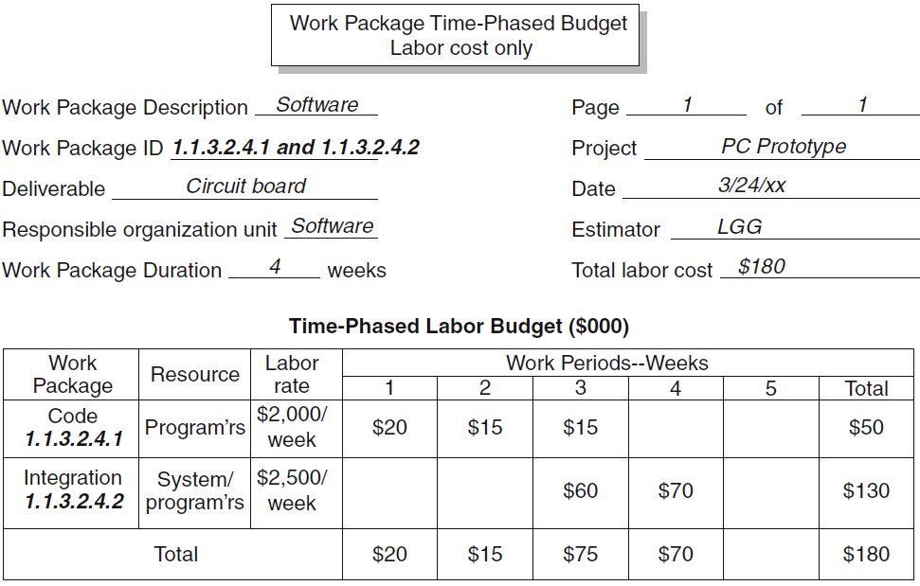

Two Time-Phased Work Packages (Labor Cost Only)

Slide 38
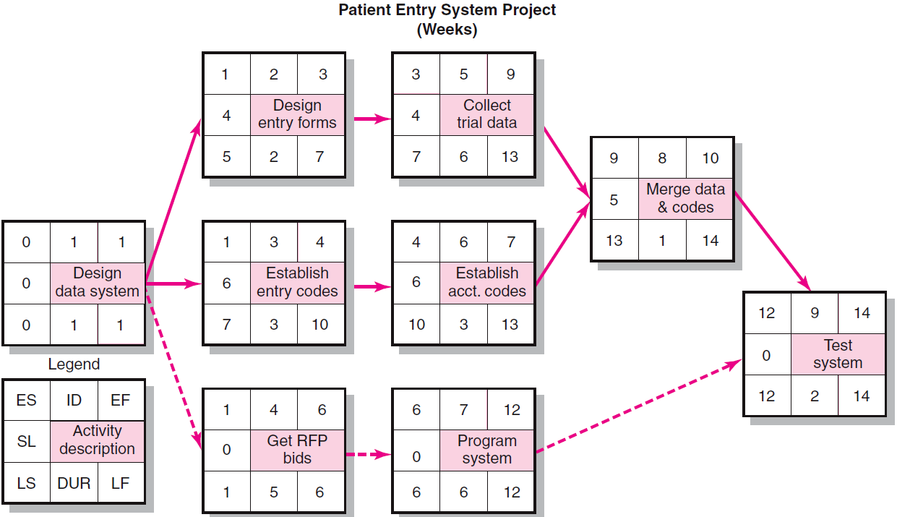

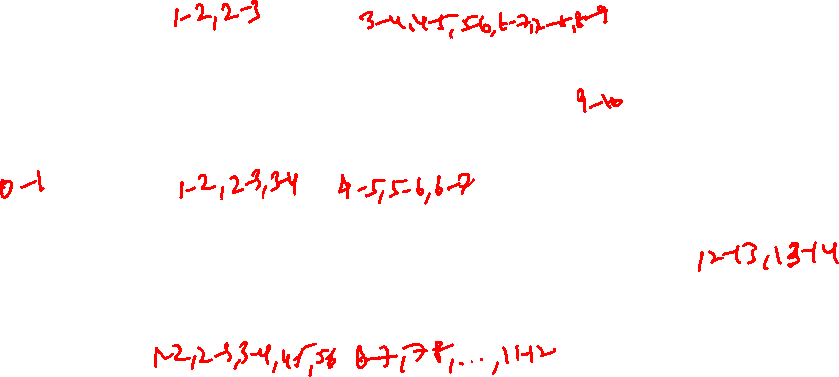
Patient Entry Project Network

Slide 39
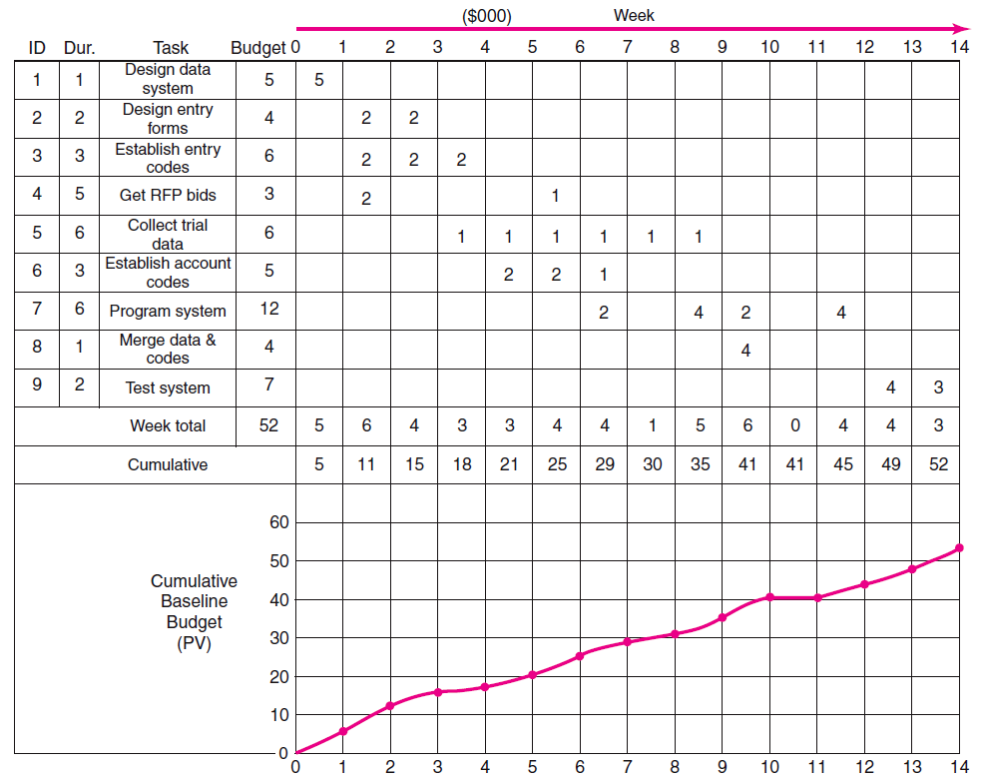
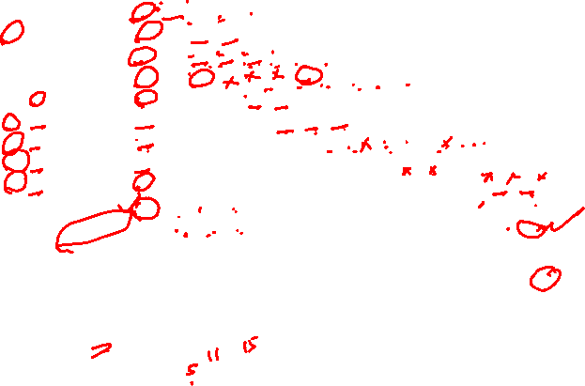
Patient Entry Time-Phased Work Packages Assigned

Slide 40
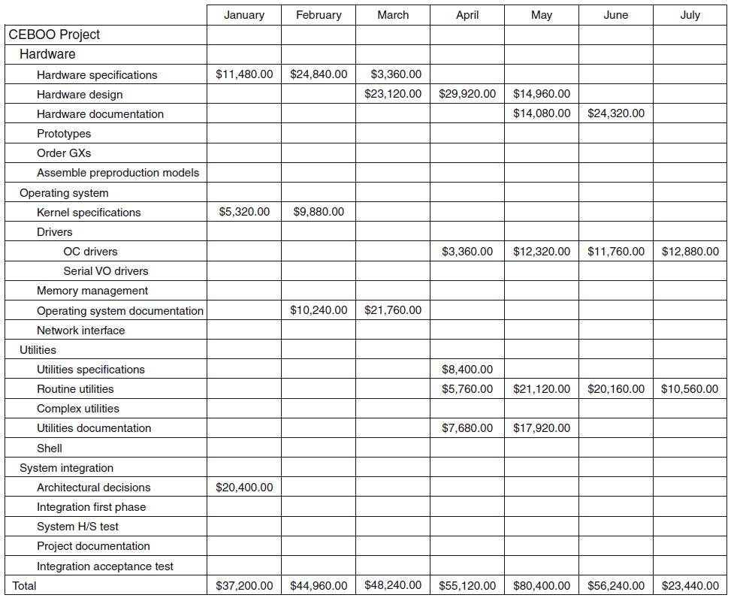

CEBOO Project Monthly Cash Flow Statement

Slide 41
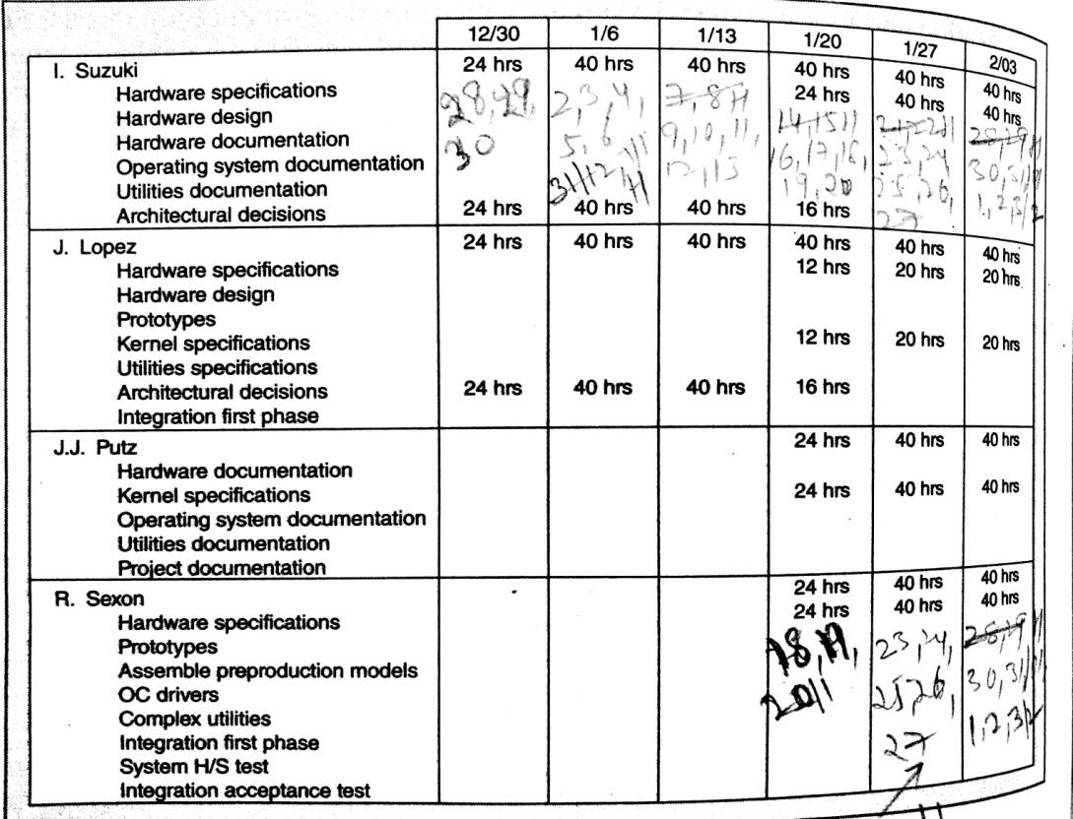
CEBOO Project Weekly Resource Usage Schedule

Slide 42
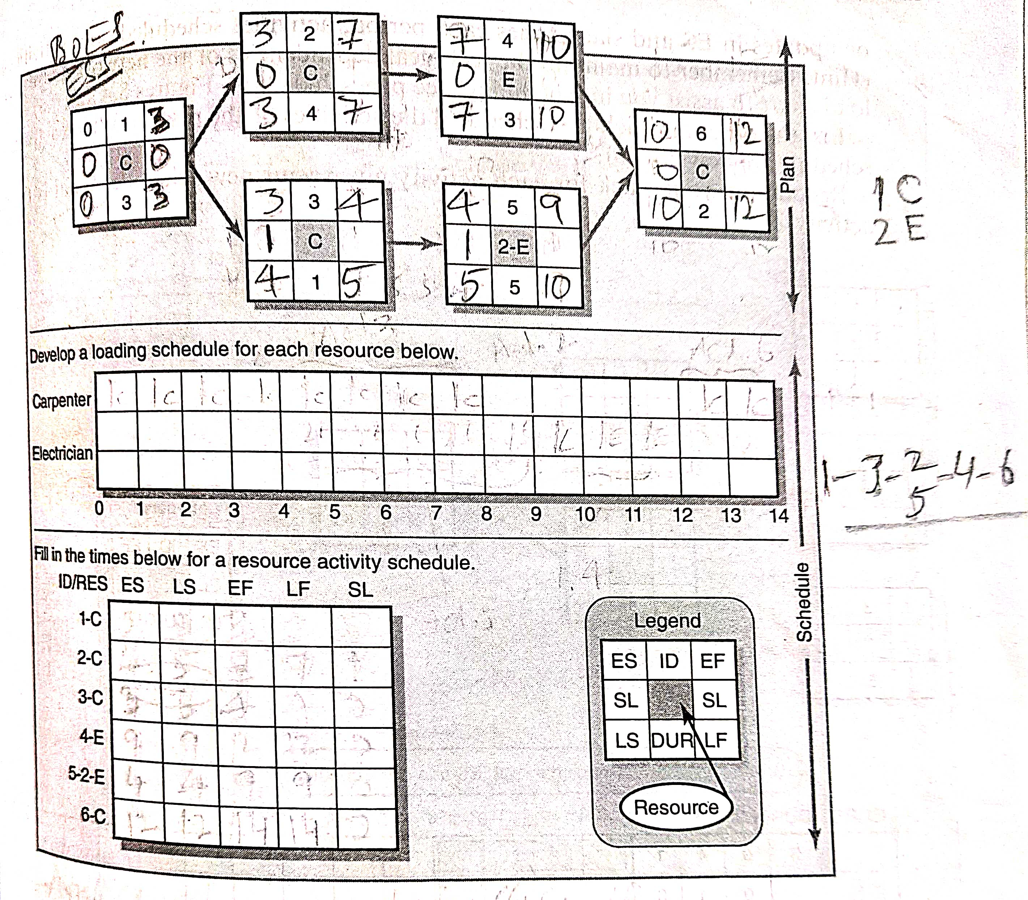

Slide 45
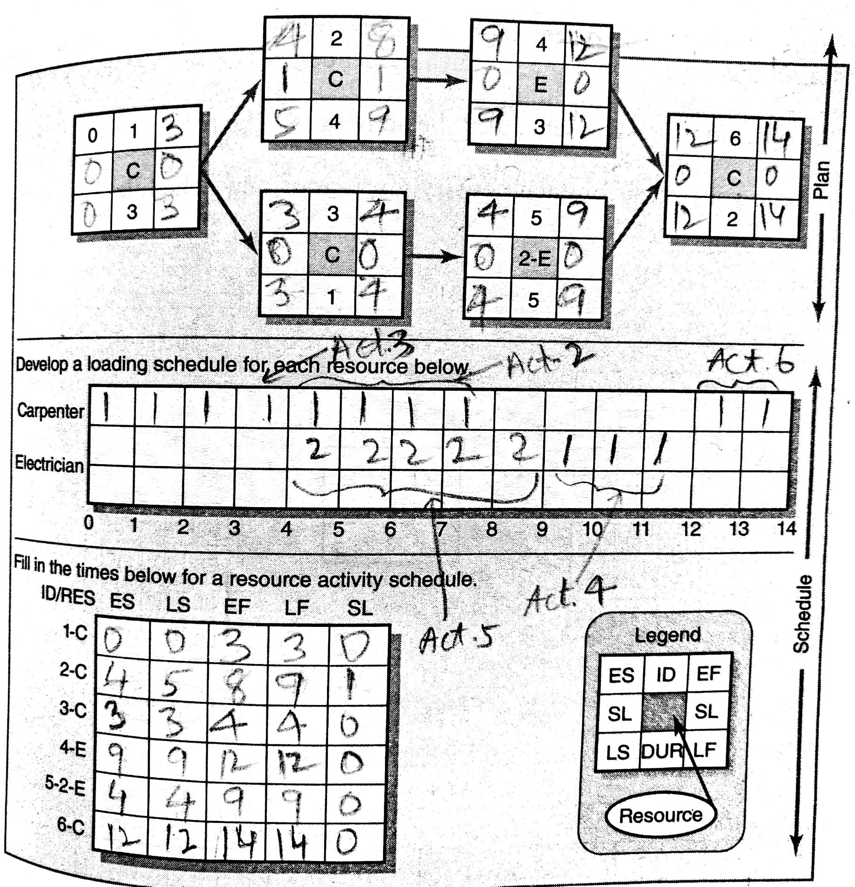
2. p 452

Slide 46
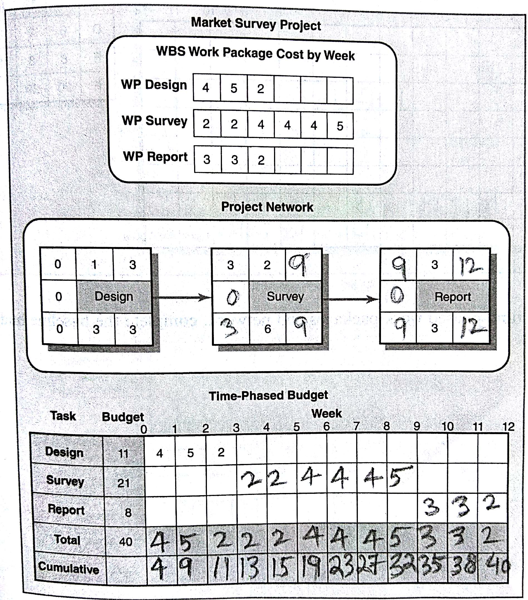
9. p 459

Slide 47
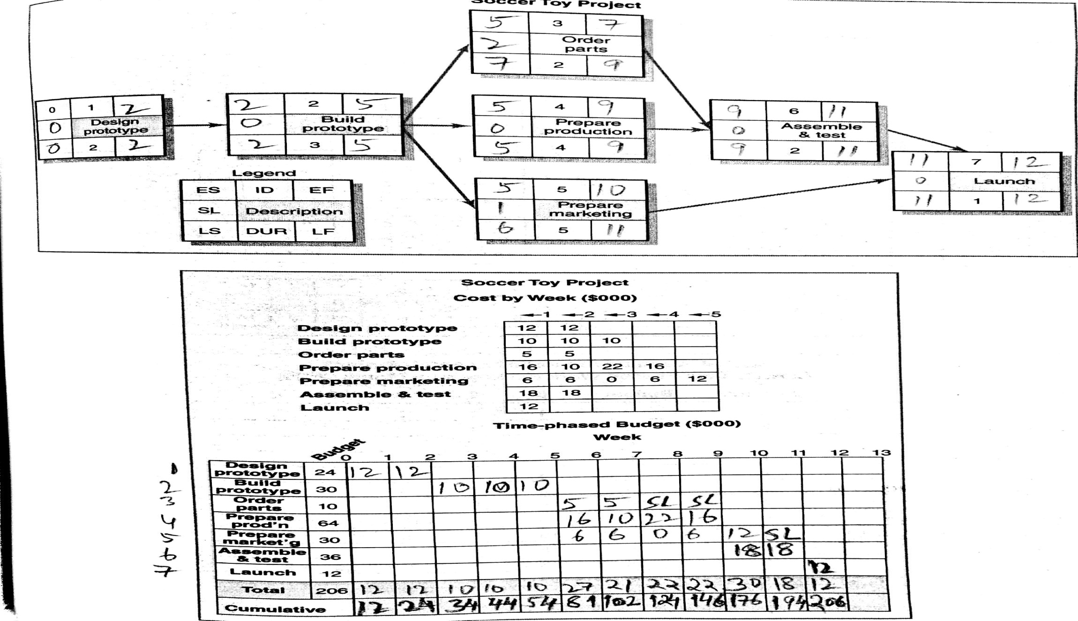
11. pp 460-461

Slide 48
Project Management
Thank You!
M K Hamirwasia

